Slide 1
Agenda
Session 3
Services
DI
Security
State
Unit Testing
Deployment
Debugging

Slide 2
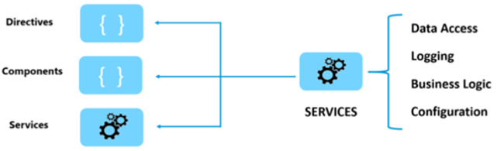
Services
Why Services?
Separation of Concerns
Sharing , reusable, discrete - functionality
Parts of service
Class
@Injectable Decorator
Provider
Services are just classes decorated with @Injectable, Instances are provided to injectors. Injectors deliver when needed.

Slide 3
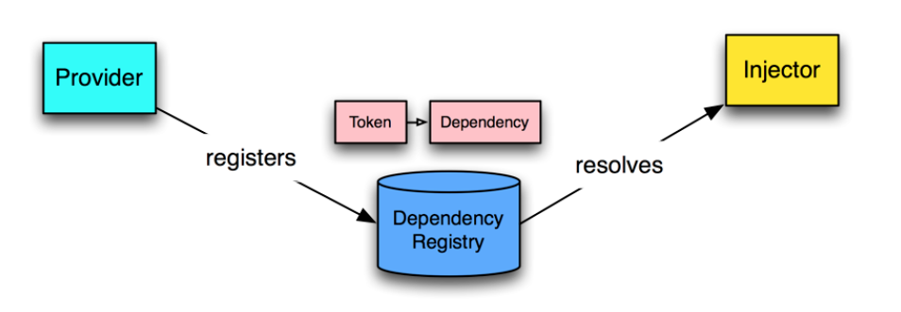
DI
The Angular DI framework consists of 4 concepts working together:
Token
This uniquely identifies something that needs to be injected. A dependency of code.
Dependency
The actual code that needs to be injected.
Provider
Maps a token (that can be a string or a class) to a list of dependencies. Provider tells Angular Injector how to create the service / an object, given a token.
Injector
This is a function which when passed a token returns/resolves a dependency (or list of dependencies) and injection them when creating objects.
Provider Recipes
UseClass
UseValue
UseFactory
UseExisting

Slide 4
Http
Observables & Callbacks
Transform Data with RxJS Operators
Operator Chaining for complex transformations
Error Handling
Encapsulate Http Errors in a service
Resolvers
Interceptors
Caching Http Requests
Testing

Slide 5
Http – RESTful CRUDs
Create
- POST – http://localhost/api/products
- If successful, returns HTTP 201 Created
Read
- GET – http://localhost/api/products OR
http://localhost/api/product/5
- If successful, returns HTTP 200 OK
Update
- PUT – http://localhost/api/product/5
- If successful, returns HTTP 204 No Content
Delete
- DELETE – http://localhost/api/product/5
- If successful, returns HTTP 204 No Content

Slide 6
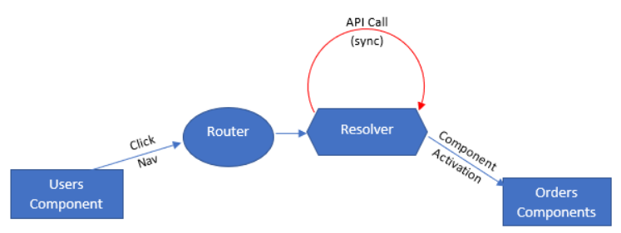
Resolvers
Fetch data before navigating
Prevent presentation of an empty
component
Prevent routing to component with errors
Provide better user experience

Slide 7
Interceptors
Interceptors are Services
Implement the HttpInterceptor interface
Manipulate HTTP requests before they’re sent to the server
Manipulate HTTP responses before they’re returned to your app
Uses of Inerceptors
Adding headers to all requests
Logging
Reporting progress events
Client Side Caching

Slide 8
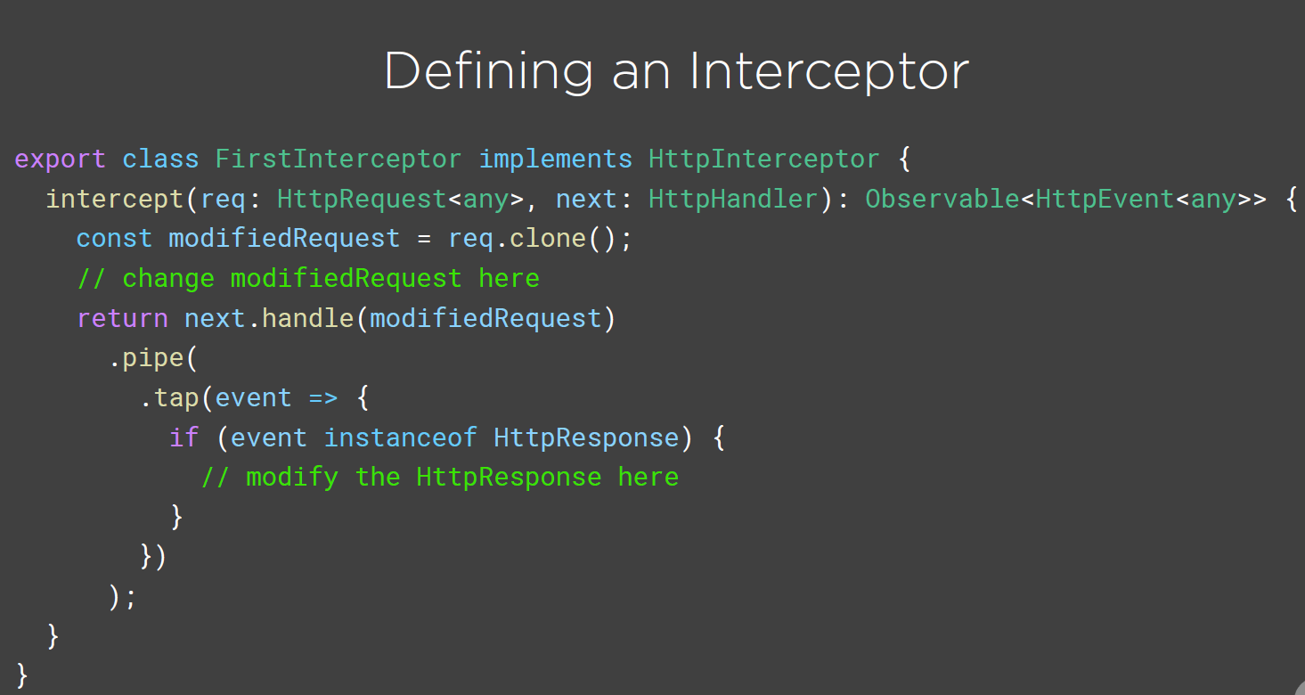
Interceptors

Slide 9
Caching Http Requests
Reduced network utilization
Reduced load on backend systems
Improved responsiveness for the end user
Cache service
Provide a data structure for the cached data
Add items to the cache
Retrieve items from the cache
Remove items from the cache (cache invalidation)
Http Testing Utilities
HttpTestingController
HttpClientTestingModule

Slide 10
Security
Authentication & Authorization
Client Authentication System
Security Service
Directives to secure UI Elements
Route Guards to secure Navigation

Slide 11
Secure Coding

Slide 12
Unit Testing
Jasmine
Karma
Angular testing utilities
Angular CLI
npm scripts

Slide 13
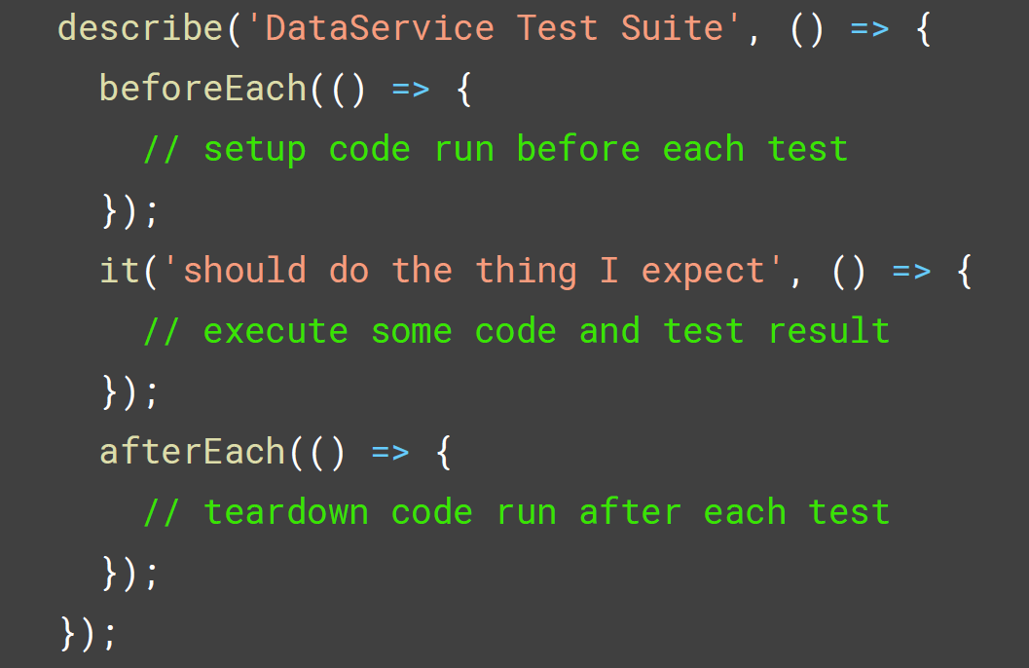
Unit Testing
Structure of Jasmine Unit Test

